Slide 1
CS 4031 Compiler Construction Chapter 9
Faryal Saud
Lecturer, Department of Computer Science
FAST NUCES CFD

Slide 2
Code Optimization
It is possible for a programmer to outperform an optimizing compiler by using his or her knowledge in choosing a better algorithm and data items. This is far from practical conditions.
In such an environment, there is need for an optimizing compiler. Optimization is the process of transformation of code to an efficient code.
Efficiency is in terms of space requirement and time for its execution without changing the meaning of the given code.

Slide 3
Need of Efficiency
Inefficient programming (which forces many invisible instructions to be performed for actual computation.)
Example:
a = a + 0
The programming constructs for easy programming.
example: Iterative loops.
Compiler generated temporary variables or instructions.

Slide 4
Constraints
The following constraints are to be considered while applying the techniques for code improvement:
The transformation must preserve the meaning of the program, that is, the target code should ensure semantic equivalence with source program.
Program efficiency must be improved by a measurable amount without changing the algorithm used in the program.
When the technique is applied on a special format, then it is worth transforming to that format only when it is beneficial enough.
Some transformations are applied only after detailed analysis, which is time consuming. Such analysis may not be worthy if the program is run very few number of times.

Slide 5
Classification of Optimizations
The optimization can be classified depending on
Level of code
Programming Language
Scope

Slide 6
Level of Code
Design level
efficiency of code can be improved by making the best use of available resources and selection of suitable algorithm.
Source code level
the user can modify the program and change the algorithm to enhance the performance of the object code.
Compile level
the compiler can enhance the program by improving the loops, optimizing on the procedure calls and address calculations. This is possible when the representation is in three address code.
Assembly level
the compiler optimizes the code based on the machine architecture and is based on the available registers and suitable addressing modes.

Slide 7
Programming Language
Machine Independent–
the code-improvement techniques that do not consider the features of the target machine are machine-independent techniques.
Constant folding, dead code elimination, and constant propagation are examples of machine-independent techniques. These are applied on either high-level language or intermediate representation.
Machine dependent
these techniques require specific information relating to target machine. Register allocation, strength reduction, and use of machine idioms are
examples of machine-dependent techniques.

Slide 8
Scope
Local
Optimizations performed within a single basic block are termed as local optimizations. These techniques are simple to implement and does not require any: analysis since we do not require any information relating to how data and control flows.
Global
optimization performed across basic blocks is called global optimizations. These techniques are complex as it requires additional analysis to be performed across basic blocks. This analysis is called data-flow analysis

Slide 9
How to Optimize
Control Flow Analysis
It determines the control structure of a program and builds a control flow graph.
Data Flow Analysis:
It determines the flow of scalar values and builds data flow graphs. The solution to flow analysis propagates data flow information along a flow graph.
Transformation:
Transformations help in improving the code without changing the meaning or functionality.

Slide 10
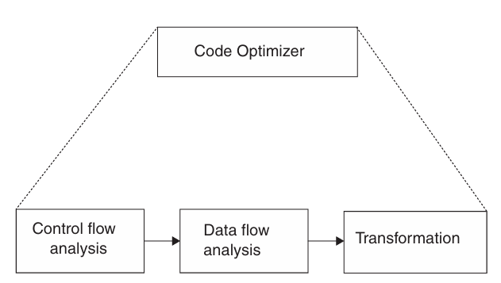
Code Optimization Model

Slide 11
Flow Graph
A graphical representation of three address code is called flow graph.
The nodes in the flow graph represent a single basic block and the edges represent the flow of control.
These flow graphs are useful in performing the control flow and data flow analysis and to apply local or global optimization and code generation.

Slide 12
Basic Block
A basic block is a set of consecutive statements that are executed sequentially.
Once the control enters into the block then every statement in the basic block is executed one after the other before leaving the block.

Slide 13
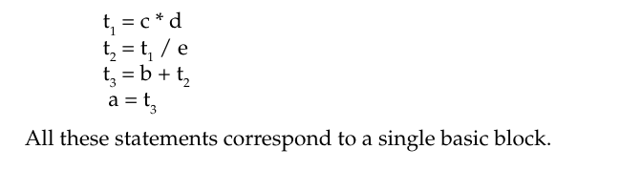
Example:
For the statement a = b + c * d/e the corresponding set of three address code is

Slide 14
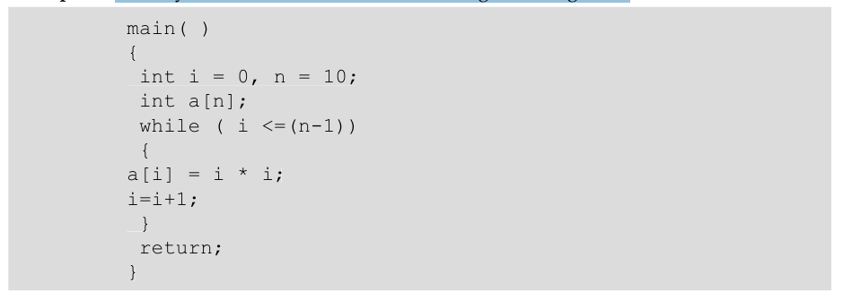
Example:
Identify the basic blocks for the following code fragment.

Slide 15
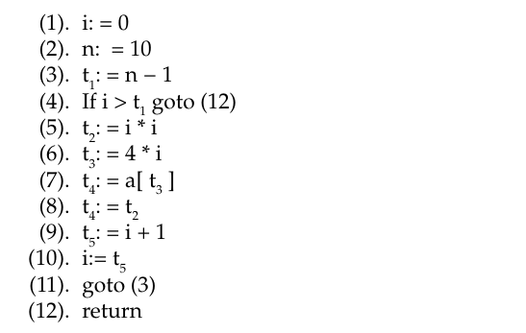
Example:
The three address code for the initialize function is as follows:

Slide 16
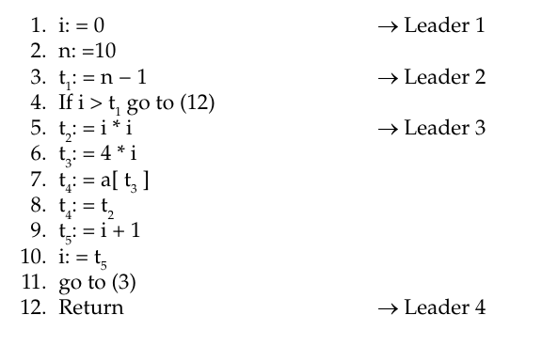
Solution
Basic block 1 includes statements (1) and (2) Basic block 2 includes statements (3) and (4) Basic block 3 includes statements (5)–(11) Basic block 4 includes statement (12)

Slide 17
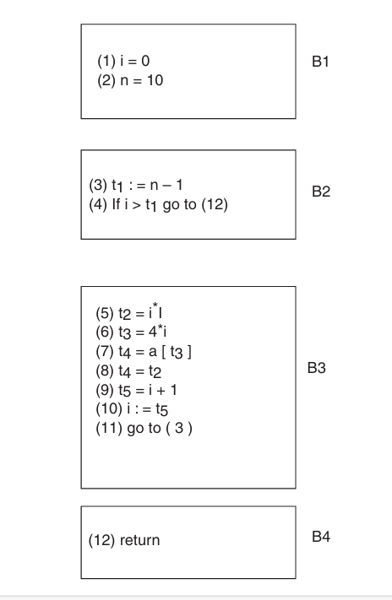
Flow Graph

Slide 18
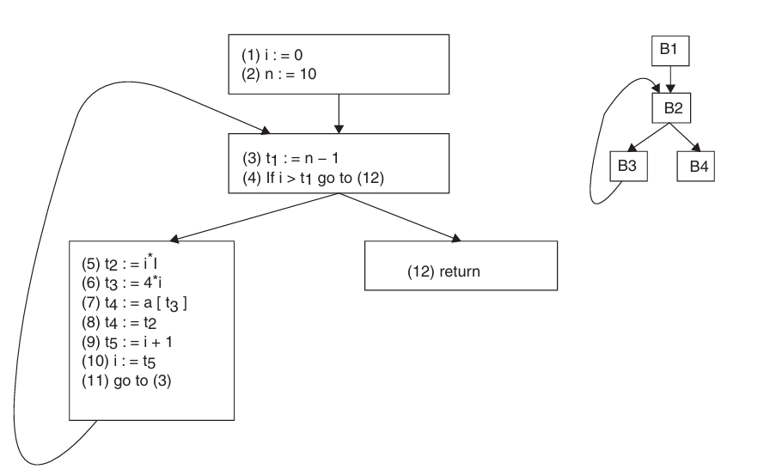
Flow Graph Control

Slide 19
DAG Representation of Basic Block
A DAG has nodes, which are labeled as follows:
The leaf nodes are labeled by either identifiers or constants. If the operators are arithmetic then it always requires the r- value.
The labels of interator nodes correspond to the operator symbol.
Some nodes are sometimes referred to by the sequence of identifiers for labels.
The interior nodes represent computed values.

Slide 20
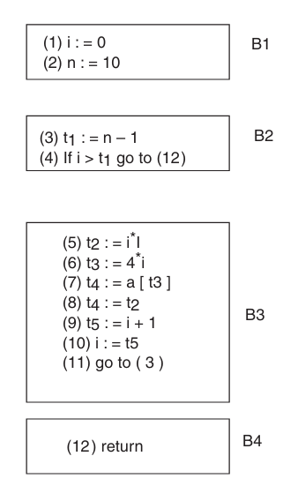
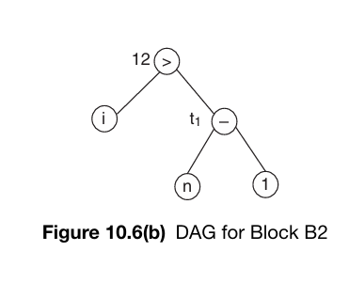
Construction of DAG

Slide 21
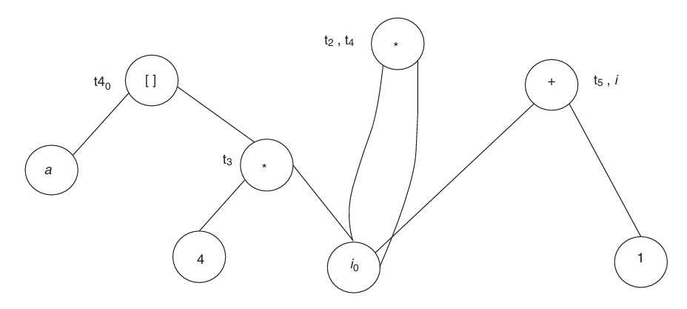
Construction of DAG

Slide 22
Example:
Create DAG for the following code:
t1 = 4 * i
t2 = a[t1 ]
t3 = b[t1 ]
t4 = t2 * t3
pr = pr + t4
i = i + 1
if i <=20
goto (1)

Slide 23
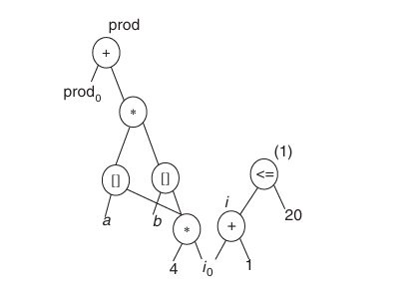
Solution:

